Slide 1






CASHEW
THE MODERN EXPENSE TRACKER

Slide 2
TABLE OF CONTENTS
Introduction
Project Objectives
Project Scope
Methodology
Technical Architecture
Results and Achievements
Conclusion

Slide 3

INTRODUCTION
The Expense Tracker Application is a simple and efficient tool designed to help users record, organize, and analyze their daily expenses. Built with Python and Tkinter, this desktop application provides an easy-to-use interface where users can:
Add expenses with category, amount, and description
View all past expenses in a structured table
Get a summary of spending by category with just one click
Store data safely in a CSV file, ensuring expenses are saved even after closing the app

Slide 4


OBJECTIVES
To create a simple and user-friendly application for managing daily expenses.
To categorize expenses for better financial planning and analysis.
To store all expenses in a persistent format (CSV file) for future reference.
To provide quick insights into spending habits through category-wise totals.
To build the application with Python and Tkinter (easy to use, lightweight).

Slide 5




PROJECT SCOPE

Slide 6

Adding expenses with date, category, amount, and description.
Viewing all past expenses in a structured tabular format.
Generating reports of total spending by category.
Data is stored locally in a CSV file, ensuring persistence.
The project is designed for students, professionals, and individuals to manage personal finances.
Future scope:
Exporting to Excel/PDF.
Data visualization using graphs.

Slide 7




METHODOLOGY
Requirement Analysis – Identify the need for expense tracking.
Design – Plan user interface using Tkinter widgets (Labels, Entries, Buttons, Treeview).
Implementation –
Python functions for adding, viewing, and summarizing expenses.
CSV file handling for data persistence.
Testing – Verify correctness of data entry, retrieval, and totals.
Deployment – Run on any system with Python installed (or convert to .exe).

Slide 8
Technical Architecture
Frontend (GUI): Tkinter (for user interaction).
Backend (Logic): Python functions for CRUD operations (Add, View, Summarize).
Database: CSV file for lightweight storage.
Libraries Used:
tkinter → GUI
csv → File handling
datetime → Date & time stamping
os → File management

Slide 9

Results and Achievements
Successfully developed a working expense tracker desktop application.
Implemented category-wise expense calculation for financial insights.
Data persistence achieved using CSV file storage.
Provided a clean and interactive GUI for users with real-time updates.
Application is lightweight, portable, and easy to extend with new features.

Slide 10

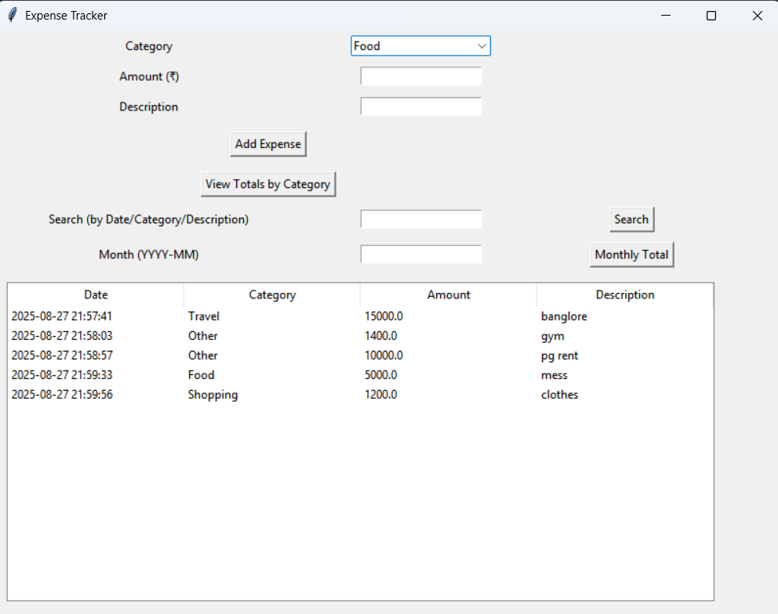



Slide 11






Created by
Ujjawal Sharma- RA2411030030054
Toib Fayaz - RA2411030030061
Santosh-RA2411030030063
Vishv Singh - RA2411030030049
B.TECH CSE CYBERSECURITY-A

Slide 12
THANK YOU!

